Slide 1

Data Visualization
NUTHAN MANIDEEP

Slide 2

ABSTRACTION
The World Happiness Report 2015 dataset contains data on the happiness levels of people in 159 countries around the world. It includes information on a variety of factors that are thought to contribute to happiness, such as economic factors (GDP per capita), social factors (family, health, and freedom), and trust in government. The data also includes a happiness score and a happiness rank for each country. The happiness score and happiness rank are based on a poll in which people were asked to rate their overall happiness on a scale of 0 to 10. The economy, family, health, freedom, trust, and generosity columns contain various measures of those factors. Overall, the World Happiness Report 2015 dataset provides valuable insights into the factors that contribute to happiness and well-being at the national level, and can be used by researchers, policymakers, and others to better understand and promote happiness around the world.

Slide 3
DATA
.
The dataset can be found on Kaggle and it contains data on happiness levels of people in 159 countries around the world. The data is collected in the year 2015 and it includes information on a variety of factors that are thought to contribute to happiness, such as:
Column Name | Description
Country or Region | Name of the country
Happiness Score | A composite score of overall well-being
Economy (GDP per Capita) | Measure of the economic production of a country
Family | Measure of social support
Health (Life Expectancy) | Measure of the health of citizens
Freedom | Measure of freedom to make life choices
Generosity | Measure of generosity of citizens
Trust (Government Corruption) | Measure of trust in government

Slide 4
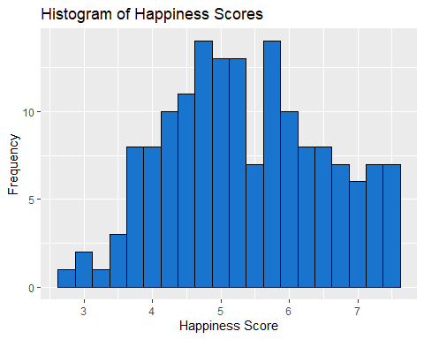
Histogram of the Happiness Scores
Based on the histogram of the 'Happiness Score' variable in the UNSDSN World Happiness dataset, the data is distributed fairly evenly around the central value. This can be seen by the symmetric shape of the histogram with no long tail in either direction. This suggests that the happiness scores are distributed relatively evenly across the 156 countries in the dataset and that there is no significant skewness in the data.

Slide 5
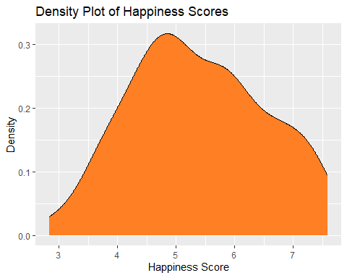
Density plot of the Happiness Scores
The density plot is similar to a histogram, but instead of showing the frequency of observations in a particular bin, it shows the density of observations at different values of the variable. This means that the area under the curve of a density plot is always equal to 1. The density plot is similar to a histogram, but instead of showing the frequency of observations in a particular bin, it shows the density of observations at different values of the variable. This means that the area under the curve of a density plot is always equal to 1.

Slide 6
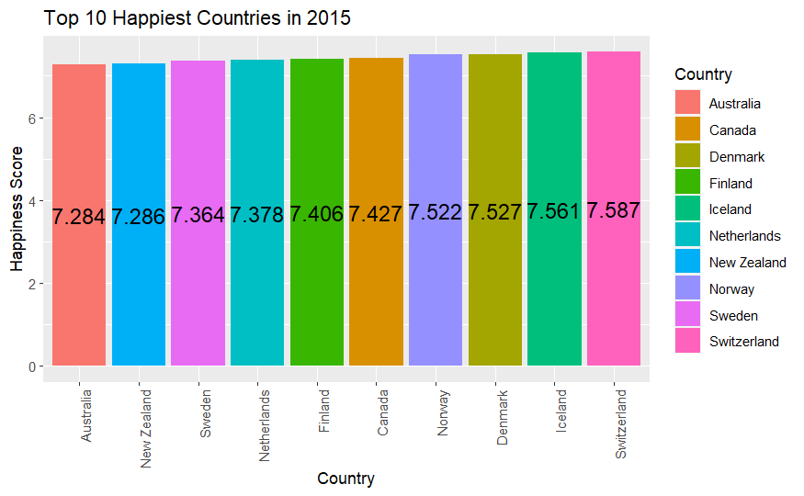
Bar plot of Top 10 Happiest Countries in 2015
The top 10 most happiest countries as per that report are Switzerland, Iceland, Denmark, Norway, Canada, Finland, Netherlands, Sweden, New Zealand and Australia.

Slide 7
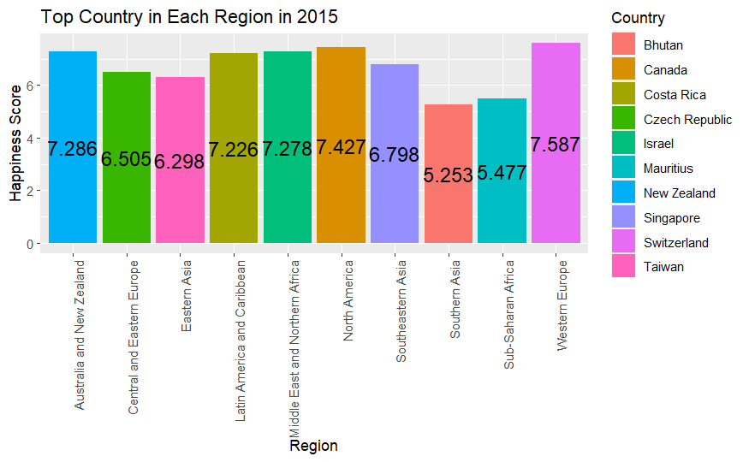
Bar plot of Happiness top country in each region in 2015
According to the World Happiness Report 2015 dataset, the top country in Western Europe based on happiness score is Switzerland, in North America is Canada, and in Australia and New Zealand is New Zealand. These countries ranked the highest in their respective regions in terms of overall happiness scores

Slide 8
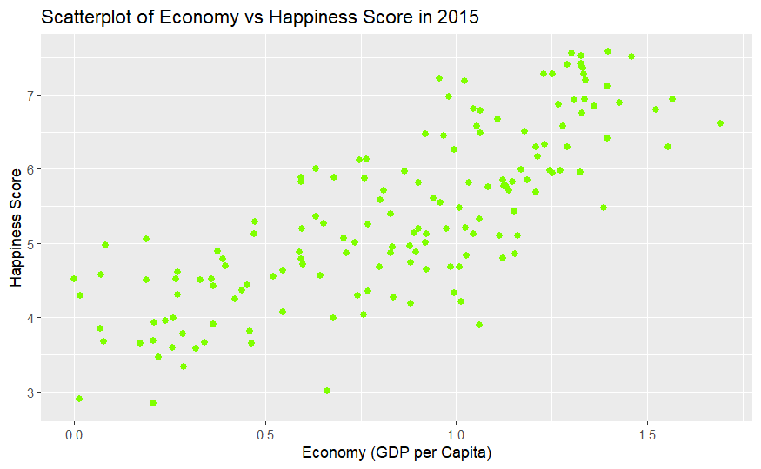
Scatterplot of Economy vs Happiness Score in 2015
The scatterplot of the relationship between economy (GDP per Capita) and happiness scores in the World Happiness Report 2015 dataset shows a positive correlation, meaning that as economy increases, happiness scores also tend to increase. This suggests that a higher GDP per capita may be associated with higher levels of happiness.

Slide 9
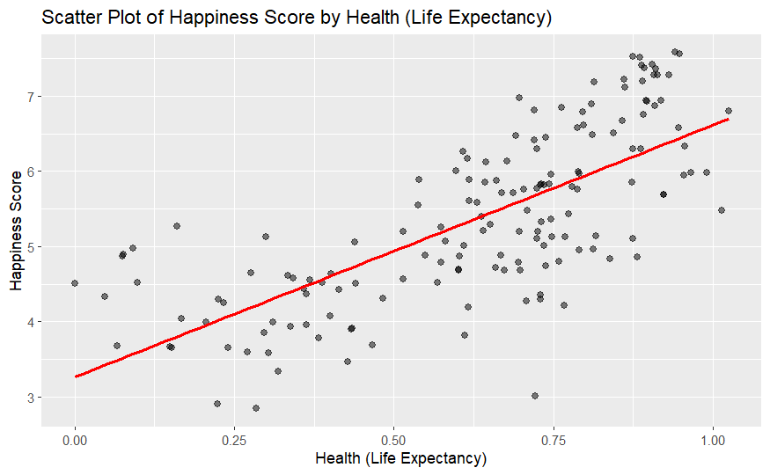
Scatterplot of Economy by Health
The scatterplot of the relationship between health (Life Expectancy) and happiness scores in the World Happiness Report 2015 dataset shows a positive correlation, meaning that as health increases, happiness scores also tend to increase.

Slide 10
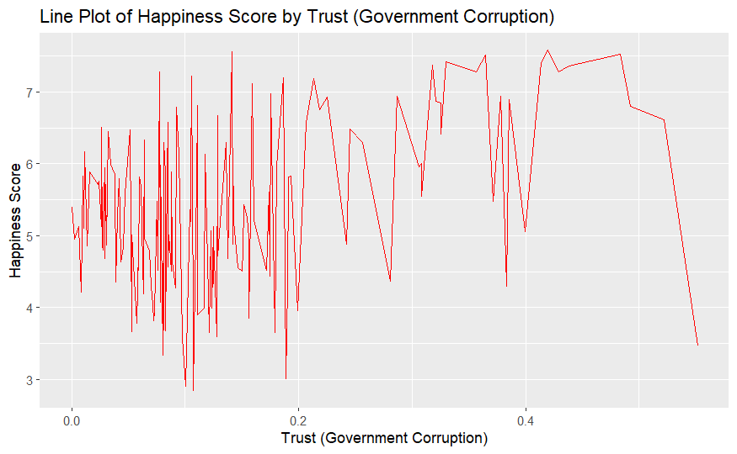
Line Plot of Happiness Score by Trust
A line plot of the relationship between trust (Government Corruption) and happiness scores in the World Happiness Report 2015 dataset shows a positive correlation, meaning that as trust increases, happiness scores also tend to increase

Slide 11
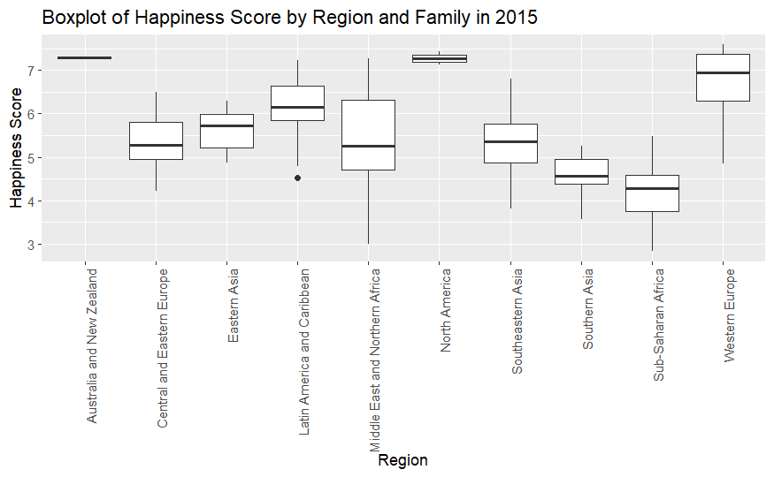
Boxplot of Happiness Score by Region and Family in 2015
A box plot of the relationship between Family and happiness scores grouped by Region in the World Happiness Report 2015 dataset shows that there is a slight positive correlation between Family and happiness scores. The box plots show that in most regions, the median happiness score increases as the family score increases.

Slide 12
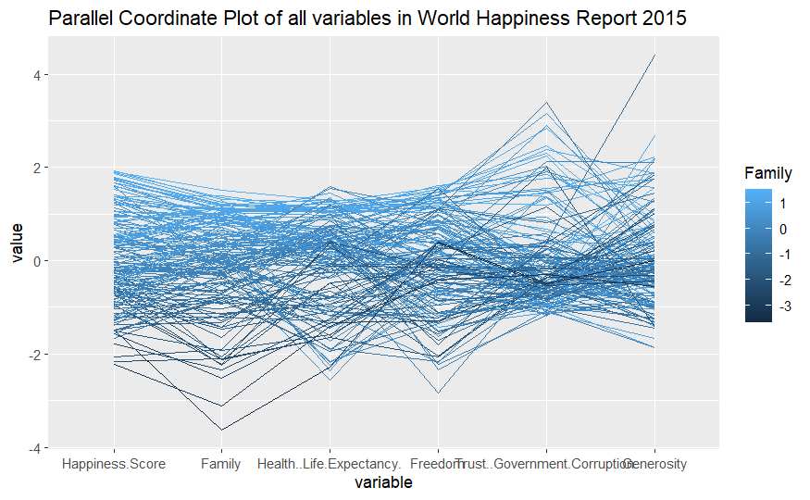
Parallel Coordinate Plot of all variables in World Happiness Report
The plot revealed that the countries with higher happiness scores tend to have higher values for most of the predictor variables. This was particularly noticeable for economy (GDP per Capita) and family. This observation aligns with the understanding that countries with higher GDP per capita and higher social support tend to have happier citizens. Additionally, variations in the values of the predictor variables across countries were observed, indicating that there are other factors besides those included in the dataset that are influencing the happiness score.

Slide 13
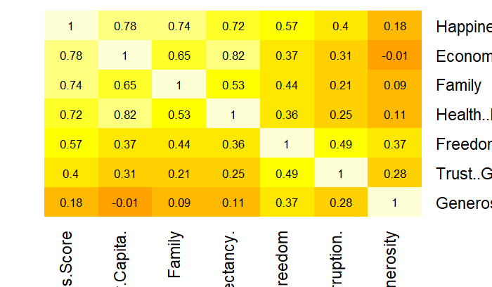
Heatmap
From the heatmap, it would be possible to see which variables are strongly correlated with the happiness score, and which variables are not. For example, a strong correlation between happiness score and variables such as economy (GDP per Capita), family, health (Life Expectancy), freedom, trust (Government Corruption), and generosity would be visible by observing cells with darker color

Slide 14
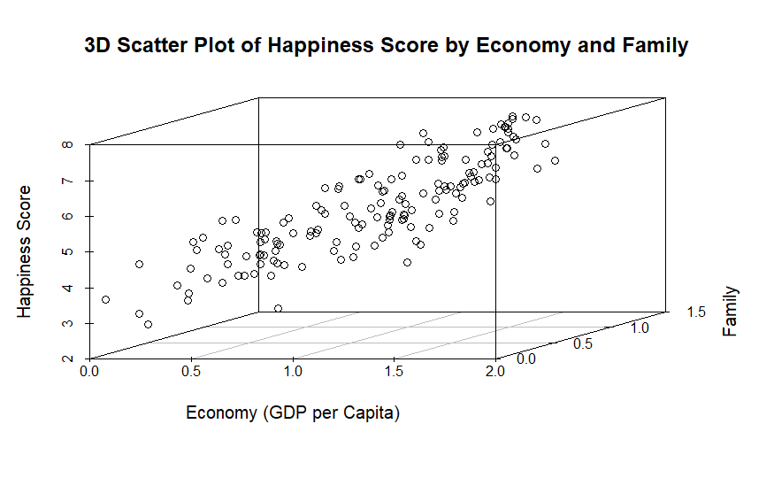
3D Scatter Plot of Happiness Score by Economy and Family
A 3D scatter plot of the relationship between Happiness Score, Economy (GDP per Capita) and Family in the World Happiness Report 2015 dataset would provide a clear visualization of how these three variables are related to each other. The plot would show that as economy and family increase, happiness score also tends to increase.

Slide 15
CONCLUSION
The World Happiness Report 2015 dataset provides valuable information on the factors that contribute to happiness scores across different countries. Data visualization techniques such as scatterplots, box plots, line plots, heatmap and parallel coordinate plot, and 3D scatter plot can be used to explore and understand the data. From the visualization it's clear that happiness scores tend to be positively correlated with variables such as economy (GDP per Capita), family, health (Life Expectancy), freedom, trust (Government Corruption), and generosity

Slide 16

Thank you!

